Slide 1
Introduction to the Clerk’s Office and CM/ECF v6.2
UNITED STATES DISTRICT COURT
Southern District of California
District Court Term Law Clerk Orientation 2018

Slide 2
Southern District of California Clerk’s Office Panel
Mickey Ochoa Chief Deputy of Administration
Jenelynn Jocson Case Services Supervisor
Notes:
Mickey/Ted

Slide 3
Agenda / Topics
Clerk’s Office Departments
Chambers SharePoint Site and Word Templates
Overview of CM/ECF v6.2 (Navigate Through Current System)
Query, Docket Sheet, NEF (Notice of Electronic Filing), CJRA Report, Motion Report, Civil Case Report, Search, Conflict Checking
Case Assignment Decks
Intake/Case Administrator Duties (s: drive - “scanned drive”)
Sealed Documents
Administration
Available Resources and Help Desk
Notes:
Mickey/Ted

Slide 4
Southern District of California Clerk of Court, John Morrill
Clerk’s Office - 333 W. Broadway
1st FL: Jury Assembly Rooms, Vending Machines
3rd FL: Balboa Training Room, Nursing Mother’s Room, Vending Machines
4th FL: Intake Lobby, Case Services Department, Records, Mail Room*, La Jolla Conference Room
5th FL: Clerk of Court, Human Resources, Procurement, Information Technology, Finance
11th FL: Interpreter Services Department, Pro Se Law Clerks
12th FL: Courtroom Deputy Department, Court Reporter/ECR Coordinator
Notes:
Mickey/Ted

Slide 5
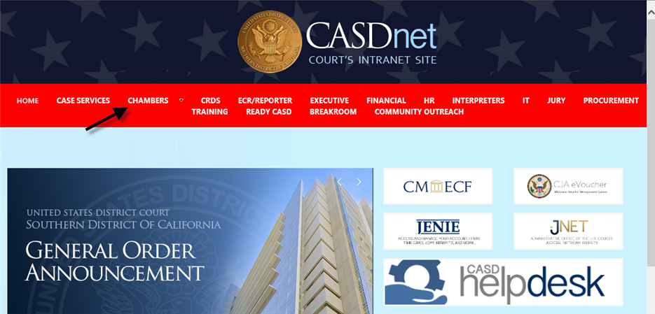
How Do I Access My Chambers SharePoint Site and Word Templates?
CASDnet (USDC Intranet Site): http://sp.casd.circ9.dcn/
Select Chambers (top menu)
Access fillable Word Templates | SP Calendar reflects CEO, CM/ECF matters
Judge Preferences | Quick Links
Reference Documents | Recent Docket Activity
Notes:
Jenelynn

Slide 6
CM/ECF v6.2 What is CM/ECF?
Case Management / Electronic Case Files System
Court Access - LIVE database: https://ecf.casd.circ9.dcn/
Query Case Number, Party Name, etc.
Deadlines/Hearings Report (Case)
Motions Report (Case)
Docket Report/Docket Sheet (Docket Sheet Data Lines)
NEF - Notice of Electronic Filing
Case Flags (see handout)
Utilities - Perform a Full Text Search
Search through all documents and docket text in CM/ECF
Docketing Orders and Minutes
Additional Training
Notes:
Jenelynn

Slide 7
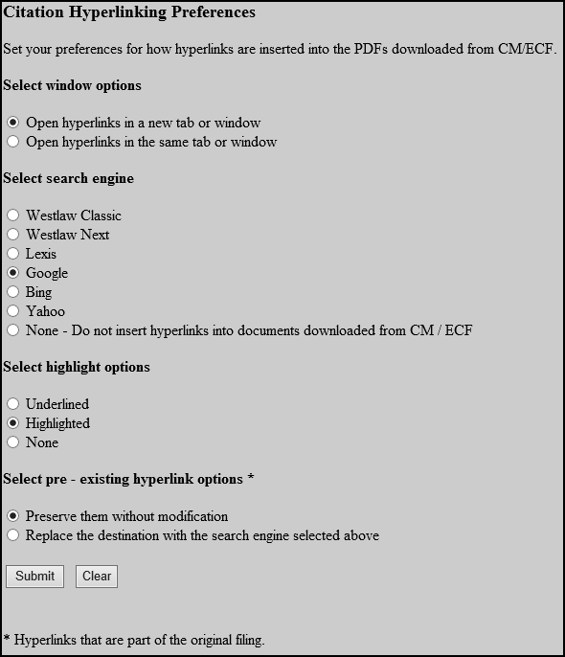
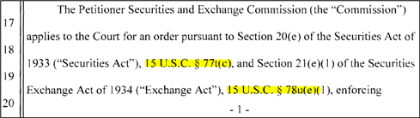
CM/ECF v6.2 What is CiteLink?
CiteLink is a program (available to Court users only) that works with CM/ECF to present legal citations in case documents (.pdf images) as hyperlinks to the Westlaw, Lexis, or other search engines, based on user preference.
Turn on CiteLink: CM/ECF Utilities - Citation Display Preferences
Notes:
Jenelynn

Slide 8
CM/ECF Reports What is CJRA?
Civil Justice Reform Act (CJRA) Report
Guide to Judiciary Policy Vol. 18 CH 5 § 540: http://jnet.ao.dcn/policy-guidance/guide-judiciary-policy/volume-18-statistics/ch-5-judges-caseload-activities#540
March 31st and September 30th
Reports -> National Statistical Reports -> Run CJRA
Motions pending more than 6 months (Referral - 7 months)
Bench trials submitted for more than 6 months
Bankruptcy appeals pending more than 6 months
Social Security appeals pending more than 6 months
Civil cases pending more than 3 years
Reports -> National Statistical Reports -> Update CJRA Status Codes
Notes:
Jenelynn

Slide 9
Case Services Department What is the Role of a Case Administrator?
Intake/Case Administrator Duties:
Open cases in CM/ECF upon receipt of initiating documents
Attorneys electronically submit cases through the “Master Case” and pay via pay.gov.
Pro Se litigants submit cases in paper via U.S. mail or in person at the 4th floor Intake window
Prisoner E-Filing Program (G.O. 653) allows the electronic submission of prisoner 42 USC § 1983 cases for those proceeding in forma pauperis
Notes:
Jenelynn

Slide 10
Case Services Department What is the Role of a Case Administrator?
Initiating documents are reviewed after submission (Master Case or paper filing)
What we look for: JS-44 Civil Coversheet, Signatures, Attorney Registration, Payment, Supporting Documents
Case Assignment via CM/ECF Case Assignment Decks
Patent Pilot Reassignments (G.O. 580)
Civil (District) | Civil (Magistrate)
Civil (District - Patent) | Civil (Magistrate - Patent/TM/Copy)
Civil (District - TM/Copy) | Civil (Magistrate - 2254)
Civil (District - Death Penalty) | Civil (Magistrate - Prisoner 1983)
 | Civil (Magistrate - Death Penalty)
 | Civil (Magistrate - Social Security)
Notes:
Jenelynn

Slide 11
Case Services Department What is the Role of a Case Administrator?
Intake/Case Administrator Duties (continued):
Receive and review incoming court documents for conformity with appropriate rules, practices and/or court requirements -> Prepare “Notices of Document Discrepancy”
Quality Control (QC) of attorney E-filed pleadings
set hearings off pleadings (chambers preference)
refer motions, if applicable (non-dispositive, discovery)
include “court only” staff notes on the docket, if appropriate
inform filers of erroneous filings (QC Mailer, calls, emails)
Example: Notice, Consent, and Reference of a Civil Action to Magistrate Judge
Notes:
Jenelynn

Slide 12
Case Services Department What is the Role of a Case Administrator?
Intake/Case Administrator Duties (continued):
Docket ORDERS from the s: drive
Make summary entries on the docket
Mark orders in CM/ECF as written opinions as defined by the Judicial Conference and required by the E-Government Act
Set future hearings/deadlines in CM/ECF -> Appear in CEO, Lotus Calendar, and SharePoint Calendar
Enter statistical closing information per order
Caption: “Order and Judgment”
Conclusion: “Clerk is ordered to close the case.”
Notes:
Jenelynn

Slide 13
CRD Department What is the Role of a Courtroom Deputy?
Courtroom Deputy Duties:
Performs Case Management
Calendaring and regulating case movement via CM/ECF and CEO (Chambers Electronic Organizer); Keeps the judge and chambers’ staff informed of case progress
Attends court sessions and conferences, conducts arraignments, swears witnesses, marks and receives exhibits, empanels jurors, and conducts telephone conference calls
Prepares and distributes documents such as calendars, judgment and commitment orders, and minute order
Maintains case management statistics
Notes:
Jenelynn

Slide 14
CM/ECF v6.2 How Are Civil Sealed Documents Processed?
Civil Sealed Documents
Attorneys must E-file civil sealed documents (non-sealed case) in CM/ECF. Note: This policy is outlined in the Electronic Case Filing Administrative Policies and Procedures Manual, Section 2.j.
Attorney will e-file the “Motion to File Documents Under Seal”
Attorney will then electronically lodge the proposed sealed document
Attorney will email proposed order to the assigned judge
If the order is granted, the Sealed Case Administrator will file the lodged document as a “Sealed Document” on the case docket.
Sealed docket entries are not visible to the public or case participants.
Sealed docket entries, sealed documents, and sealed cases are only accessible by judges/chambers assigned to the case, CRDs, and specific Case Administrators assigned to manage sealed information.
Notes:
Jenelynn

Slide 15
CM/ECF v6.2 Where Can I Find More Information?
Case Services SharePoint Site - Docketing Assignments: http://sp.casd.circ9.dcn - Case Services - Docketing Assignments
Electronic Case Filing Administrative Policies and Procedures Manual: https://www.casd.uscourts.gov - CMECF - Policies and Procedures
Electronic Learning Modules (How to File a New Civil Case, How to E-filed Civil Sealed Documents, etc.): https://www.casd.uscourts.gov - CMECF - Policies and Procedures
CASD Training Tutorials: http://sp.casd.circ9.dcn - Training - Automation Training - Training Tutorials
Notes:
Jenelynn

Slide 16
Administration How Can the I.T. Department Help?
Information Technology Department
Sergio Pinto - Director of Information Technology
619-557-5705 (office) or 619-247-9732 (work iPhone)
619-557-5412 (Help Desk) or CASD HelpDesk Ticket (SharePoint/Intranet)
* I.T. Operational/PC Support – charged with maintaining and supporting all PC functions and courtroom technology
* Network Support – charged with maintaining, securing and supporting court’s network systems
* Programming Support- charged with supporting existing and developing new programs
Notes:
Mickey

Slide 17
Administration How Can Facilities and Procurement Help?
Facilities and Procurement Department
Brian Teague – Facilities/Procurement Supervisor
619-557-6293 (office) or 619-805-6815 (work iPhone)
619-557-6780 (Help Desk) or CASD HelpDesk Ticket (SharePoint/Intranet)
* Facilities Support – charged with supporting and resolving all facility related issues such as temperature, lighting, repairs, building maintenance and janitorial services. All requests for facility related repair requests must come through this department, who then works with GSA through resolution.
* Procurement Support – charged with procuring and contracting all goods and services in accordance with federal and judicial regulation. Federal law forbids employees who are not delegated, certified contracting officers from procuring, obligating or contracting for goods or services that are to be funded from appropriated funds.
Notes:
Mickey

Slide 18
Administration How Can Human Resources Help?
Human Resources Department
Mina Guzman - Human Resources Supervisor
619-557-2959 (office) or 619-805-6822 (work iPhone)
* Staff Onboarding and Departure
* Security Access Cards
* Benefits and Payroll
Notes:
Mickey

Slide 19
Administration How Can Finance Help?
Finance Department
Laura Jimenez - Financial Supervisor
619-557-6366 (office) or 619-602-8876 (work iPhone)
* Travel Services – employee travel experts - charged with reviewing and certifying that travel reimbursement requests follow all judiciary travel regulations and then processing approved vouchers for payment. Once judge approves law clerk travel, authorizes charges to court’s credit card for air travel arranged through National Travel.
* Deposit and Withdrawal of moneys in pending or adjudicated cases (Registry Funds), including Interpleader funds and bonds for costs. Also holds personal and real property in accordance with Court’s order.
Notes:
Mickey

Slide 20
Administration - Interpreter Services Department, Jury Department Who Should I Contact?
Interpreters Department
Gloria Mayne - Manager of Interpreter Services
619-557-5205 (office) or 619-250-4179 (work iPhone)
Jury Department
Irma Fletes - Jury Administrator
619-446-3750 (office) or 619-865-1125 (work iPhone)
Notes:
Mickey

Slide 21
CM/ECF v6.2, SharePoint, Microsoft Word, etc. Where Can I Find Support?
Jenelynn Jocson - Case Services Supervisor (Team 1)
619-557-7356 (office) or 619-756-4174 (work iPhone)
jenelynn_jocson@casd.uscourts.gov
Joseph Diaz - CM/ECF Coordinator
619-557-5601 (office) or 619-807-6227 (work iPhone)
joseph_diaz@casd.uscourts.gov
Daniel Nanula - CM/ECF Administrator
619-557-7440 (office) or 619-665-8476 (work iPhone)
daniel_nanula@casd.uscourts.gov
Mike Cruz - CM/ECF Administrator
619-557-7355 (office) or 619-787-2301 (work iPhone)
mike_cruz@casd.uscourts.gov
Notes:
Jenelynn

Slide 22
Operations Who Can Provide Operational Support?
Jamie Ponzio - Case Services Supervisor (Team 2)
619-557-7613 (office) or 619-843-4531 (work iPhone)
jamie_ponzio@casd.uscourts.gov
Laura Barkins - District CRD Supervisor
619-557-6416 (office) or 619-507-8672 (work iPhone)
laura_barkins@casd.uscourts.gov
Roi-Ann Bressi - Magistrate CRD Supervisor
619-557-6415 (office) or 619-318-6220 (work iPhone)
roi-ann_bressi@casd.uscourts.gov
Notes:
Jenelynn

Slide 23
Introduction to the Clerk’s Office and CM/ECF v6.2
UNITED STATES DISTRICT COURT
Southern District of California
District Court Term Law Clerk Orientation 2018

